Slide 1
Distributed Computer Security
Lecture 8
Authentication, Key distribution,
Kerberos, PGP
Jianjun Zhang

Slide 2
Today’s topic
Authentication
Key management
Kerberos
Secured E-mail and PGP

Slide 3



Authentication
Goal: Bob wants Alice to “prove” her identity to him
Protocol ap1.0: Alice says “I am Alice”
“I am Alice”
Failure scenario??

Slide 4
Authentication
Goal: Bob wants Alice to “prove” her identity to him
Protocol ap1.0: Alice says “I am Alice”
in a network,
Bob can not “see” Alice, so Trudy simply declares
herself to be Alice
“I am Alice”

Slide 5
Authentication: another try
Protocol ap2.0: Alice says “I am Alice” in an IP packet
containing her source IP address
Alice’s
IP address
“I am Alice”
Failure scenario??

Slide 6
Authentication: another try
Protocol ap2.0: Alice says “I am Alice” in an IP packet
containing her source IP address
Trudy can create
a packet “spoofing”
Alice’s address
Alice’s
IP address
“I am Alice”

Slide 7
Authentication: another try
Protocol ap3.0: Alice says “I am Alice” and sends her
secret password to “prove” it.
Alice’s
IP addr
Alice’s
password
“I’m Alice”
Failure scenario??
Alice’s
IP addr
OK

Slide 8

Authentication: another try
Protocol ap3.0: Alice says “I am Alice” and sends her
secret password to “prove” it.
Alice’s
IP addr
Alice’s
password
“I’m Alice”
playback attack: Trudy records Alice’s packet
and later
plays it back to Bob
Alice’s
IP addr
OK
Alice’s
IP addr
Alice’s
password
“I’m Alice”

Slide 9
Authentication: yet another try
Protocol ap3.1: Alice says “I am Alice” and sends her
encrypted secret password to “prove” it.
Alice’s
IP addr
encrypted
password
“I’m Alice”
Failure scenario??
Alice’s
IP addr
OK

Slide 10
Authentication: another try
Protocol ap3.1: Alice says “I am Alice” and sends her
encrypted secret password to “prove” it.
Alice’s
IP addr
encrypted
password
“I’m Alice”
record
and
playback
still works!
Alice’s
IP addr
OK
Alice’s
IP addr
encrypted
password
“I’m Alice”

Slide 11
Authentication: yet another try
Goal: avoid playback attack
Nonce: number (R) used only once –in-a-lifetime
ap4.0: to prove Alice “live”, Bob sends Alice nonce, R. Alice
must return R, encrypted with shared secret key
“I am Alice”
R
K (R)
Alice is live, and only Alice knows key to encrypt nonce, so it must be Alice!
A-B
Failures, drawbacks?

Slide 12
Authentication: ap5.0
ap4.0 requires shared symmetric key
can we authenticate using public key techniques?
ap5.0: use nonce, public key cryptography
“I am Alice”
Bob computes
R
+
-
-
K
(K (R)) = R
K (R)
A
A
A
and knows only Alice could have the private key, that encrypted R such that
“send me your public key”
+
K
A
+
-
K
(K (R)) = R
A
A

Slide 13
ap5.0: security hole
Man in the middle attack: Trudy poses as Alice (to Bob) and as Bob (to Alice)
I am Alice
I am Alice
R
-
K (R)
T
R
-
Send me your public key
K (R)
+
A
K
Send me your public key
T
+
K
A
+
K (m)
Trudy gets
T
+
-
+
K (m)
m = K (K (m))
A
T
T
sends m to Alice encrypted with Alice’s public key
-
+
m = K (K (m))
A
A

Slide 14
ap5.0: security hole
Man in the middle attack: Trudy poses as Alice (to Bob) and as Bob (to Alice)
Difficult to detect:
Bob receives everything that Alice sends, and vice versa. (e.g., so Bob, Alice can meet one week later and recall conversation)
problem is that Trudy receives all messages as well!

Slide 15
Key Management
Symmetric key distribution
  Diffie-Hellman method
  Man-in-the-middle attack
  Key distribution center
Public key certification
  X.509
  PKI
  CA

Slide 16
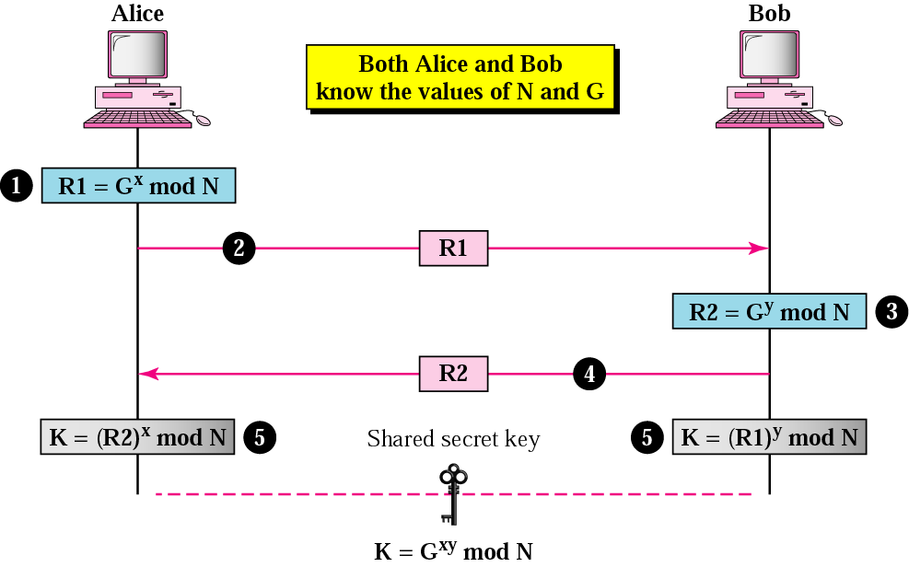
Diffie-Hellman method

Slide 17
Diffie-Hellman Example
Assume G = 7 and N = 23. The steps are as follows:
1. Alice chooses x = 3 and calculates R1 = 7³ mod 23 = 21.
2. Alice sends the number 21 to Bob.
3. Bob chooses y = 6 and calculates R2 = 7⁶ mod 23 = 4.
4. Bob sends the number 4 to Alice.
5. Alice calculates the symmetric key K = 4³ mod 23 = 18.
6. Bob calculates the symmetric key K = 21⁶ mod 23 = 18.
The value of K is the same for both Alice and Bob;
G^{xy} mod N = 7¹⁸ mod 23 = 18.

Slide 18
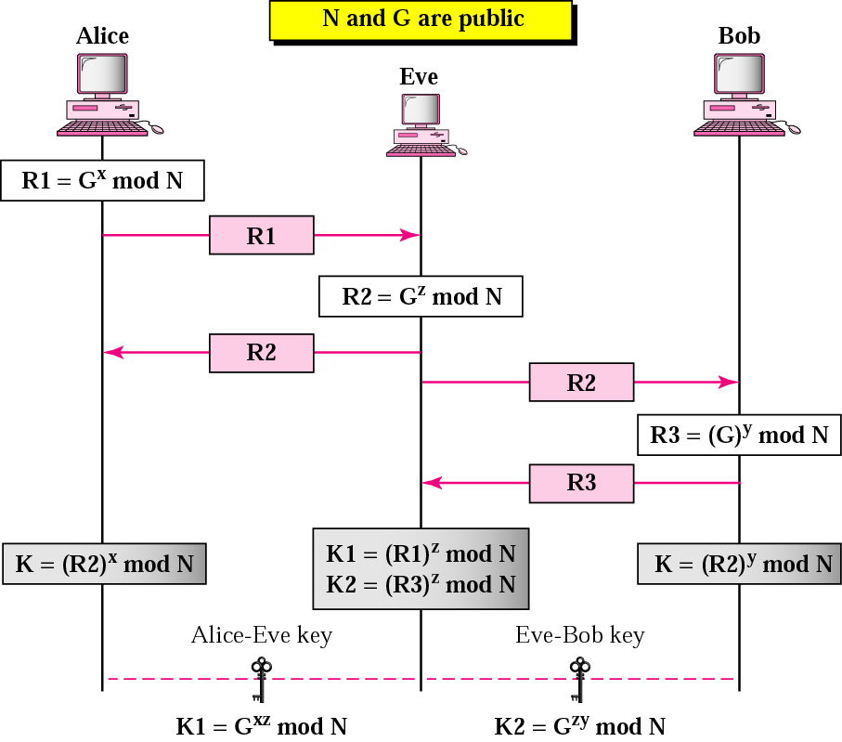
Man-in-the-middle attack

Slide 19



Certification Authorities
Certification authority (CA): binds public key to particular entity, E.
E (person, router) registers its public key with CA.
  E provides “proof of identity” to CA.
  CA creates certificate binding E to its public key.
  certificate containing E’s public key digitally signed by CA – CA says “this is E’s public key”
Bob’s
public
key
digital
signature
(encrypt)
+
K
+
B
K
B
CA
private
key
certificate for Bob’s public key, signed by CA
Bob’s
identifying information
-
K
CA

Slide 20
Certification Authorities
When Alice wants Bob’s public key:
  gets Bob’s certificate (Bob or elsewhere).
  apply CA’s public key to Bob’s certificate, get Bob’s public key
+
digital
signature
(decrypt)
Bob’s
public
key
K
B
+
K
B
CA
public
key
+
K
CA

Slide 21
X.509 fields
Field | Explanation
Version | Version number of X.509
Serial number | The unique identifier used by the CA
Signature | The certificate signature
Issuer | The name of the CA defined by X.509
Validity period | Start and end period that certificate is valid
Subject name | The entity whose public key is being certified
Public key | The subject public key and the algorithms that use it

Slide 22
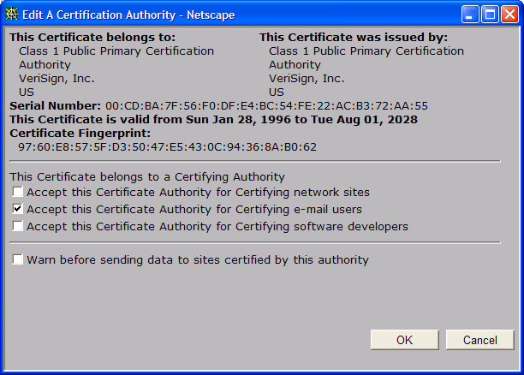
A certificate contains:
Serial number (unique to issuer)
info about certificate owner, including algorithm and key value itself (not shown)
info about certificate issuer
valid dates
digital signature by issuer

Slide 23
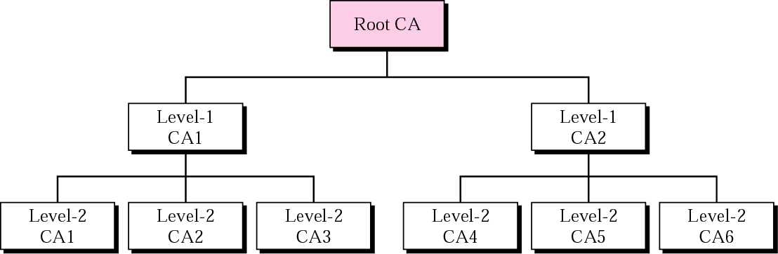
PKI hierarchy

Slide 24
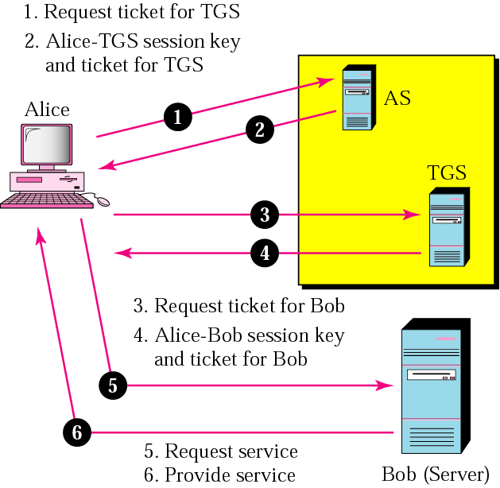
Kerberos servers

Slide 25
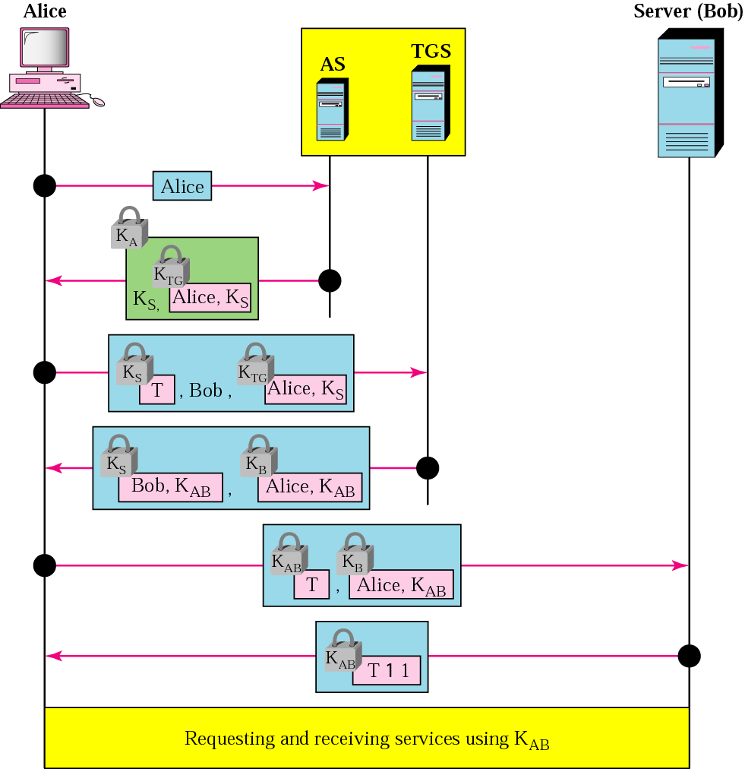
Kerberos examples

Slide 26
Kereberos
A Network authentication protocol which involves the client proving who it is to the server, and the server doing the same to the client
Authentication Server: a server that is trusted by both the client and server, a ‘middle man’ (e.g. passport issuing authority)
Ticket: granted by the authentication server to both client and server in question
  Time stamped to prevent reuse
  Ticket presented to server
- אבטחת רשתות – אדריאן שפלר -

Slide 27

CHAP
Challenge Handshake Protocol
  Used to authenticate across a point-to-point link using PPP
Server sends randomly generated value (challenge) to client
Both calculate response based on pre-agreed value using a one way hash function
If the results of both is the same, communication continues
- אבטחת רשתות – אדריאן שפלר -

Slide 28
Certificates and Tokens
Certificates
  Normally used to authenticate specific objects, such as an individuals public key or downloaded software
Tokens
  Normally a hardware device that can be used in a challenge/response authentication process
  E.g. a device with an LCD panel with a password which is constantly changing. On log-on user enters the ‘current’ password, which proves they are legitimate (illegitimate user needs token)
- אבטחת רשתות – אדריאן שפלר -

Slide 29
Multifactor & Mutual Authentication
Multifactor Authentication
  E.g. a smartcard PLUS a password (something you have + something you know – e.g. PIN)
Mutual Authentication
  How does the user know that the machine they are handing over their authentication details to is intended destination?
- אבטחת רשתות – אדריאן שפלר -

